Slide 1
Meet The teacher
YEAR 5
Welcome to

Slide 2

Welcome to Year 5
Mrs Griffiths- Mondays and Tuesdays
Mrs Varndall- Wednesdays, Thursdays and Fridays
Other support in class- Mrs Howie and Mrs Holden
Please contact us via the office email, by popping into the office or catching us at the end of the day to arrange a meeting

Slide 3
Well-being
As the children settle into the routine of school life again after the long summer break, our priority is to ensure the children are feeling happy and settled.
We provide lots of opportunities to connect by sharing home news, celebrating achievements, discussing any worries and thinking about the positives we can find from each day.
(Ask your child about Peanut!)
Our daily routine includes opportunities to share prayer-time together in collective worship, as well as lunch and home-time prayers.

Slide 4
Daily routine
School doors open 8:40am
8:45am registration
Lunch play-time is at 12:30pm and time to eat is at 12:45pm
Please send your child in each day with a water bottle and a mid-morning fruit or veg snack as it is a very long morning for them

Slide 5
PE Days
Indoor PE is a Thursday afternoon
Outdoor PE is Friday morning
There may be occasional changes to this so please just send your child in with a PE kit each week.

Slide 6


Celebrations
We celebrate the children in Year 5 by using Golden Tickets, our class Star Jar, House Points, Certificates, Stickers and visits to show other members of staff work.
We have a whole-school celebration assembly every Thursday so if your children have anything from outside of school to celebrate then please do send them in with it.

Slide 7
Homework
Maths
Sent home on a Monday - to be handed in the following Monday
Reading Comprehension sheets
Sent home on a Monday - to be handed in the following Monday
Accelerated Reader quizzes
Please read with your child daily and ask them to do an AR quiz on books they have finished
Please ask if you need your child's AR log-in details
Spellings
Test on a Friday (more on next slides)

Slide 8
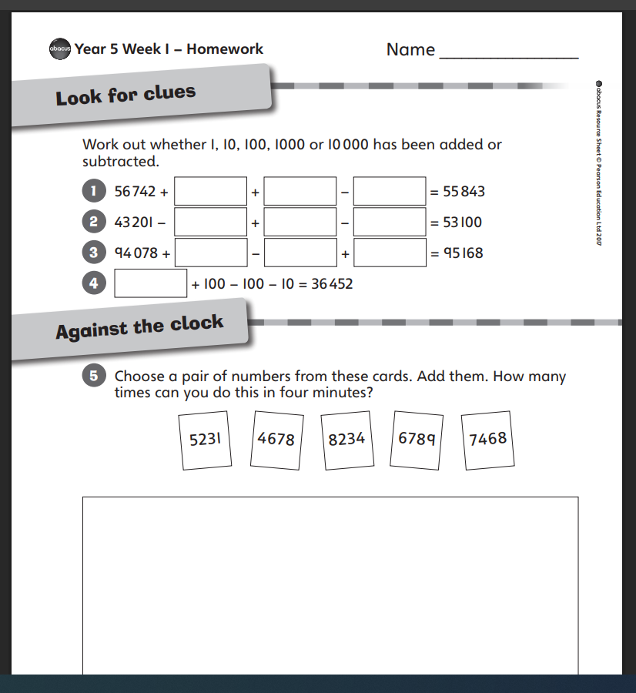
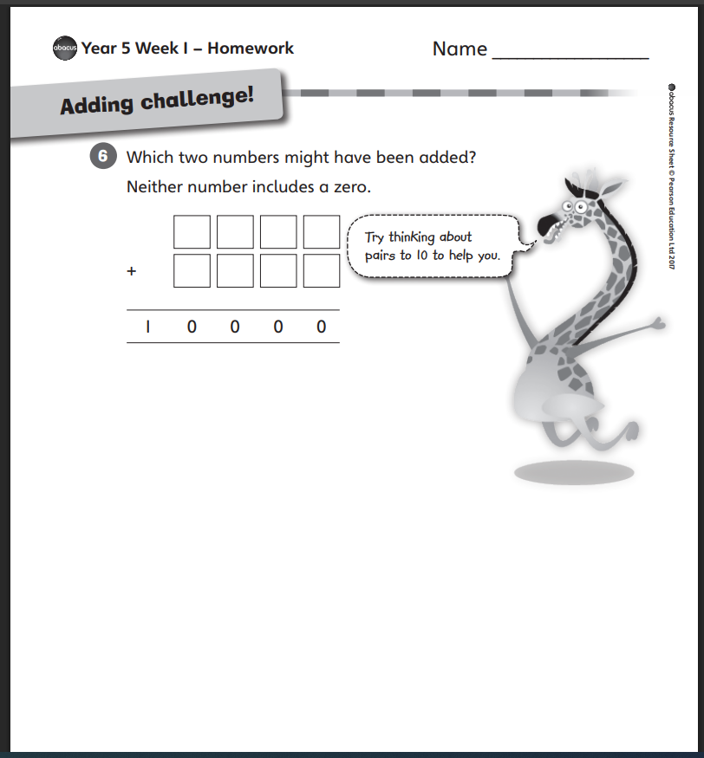
Maths

Slide 9
Spellings
This year the whole school is using the same spelling scheme to ensure they are learning the key spellings for their year group with accuracy and fluency within their writing.
Children in each class therefore all have the same spellings to learn weekly, instead of three different variations like in previous years.
You should have received this half term’s spellings but let us know if you need another copy.
The children will also bring home a weekly list to practise using Look, Say, Cover, Write, Check.
If these are too challenging for your child, there is no pressure to learn all 10 each week. It is up to your child and yourself to decide if they focus on securing only 5 one week for example.
Children will need to know which ones they have practised so during the test they know which ones to answer.
For our more confident spellers, it is important that the children are not just learning the spellings each week for the tests and then not remembering how to spell them within their writing.
Your child could write some sentences using their weekly spellings to ensure they can spell them, as well as have a clear understanding of the meaning.
They could even write a short story and highlight each spelling.

Slide 10
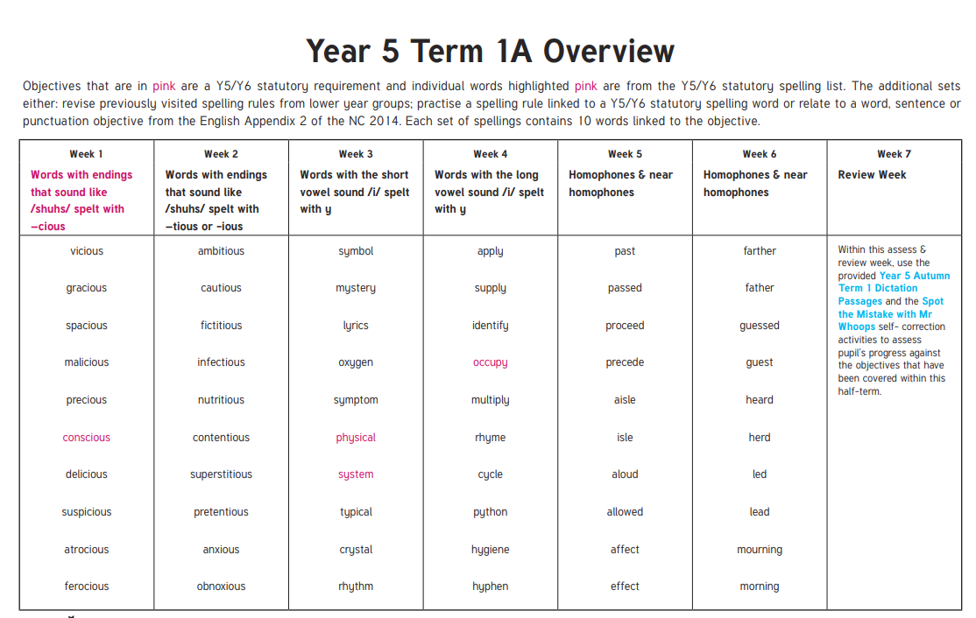

Slide 11
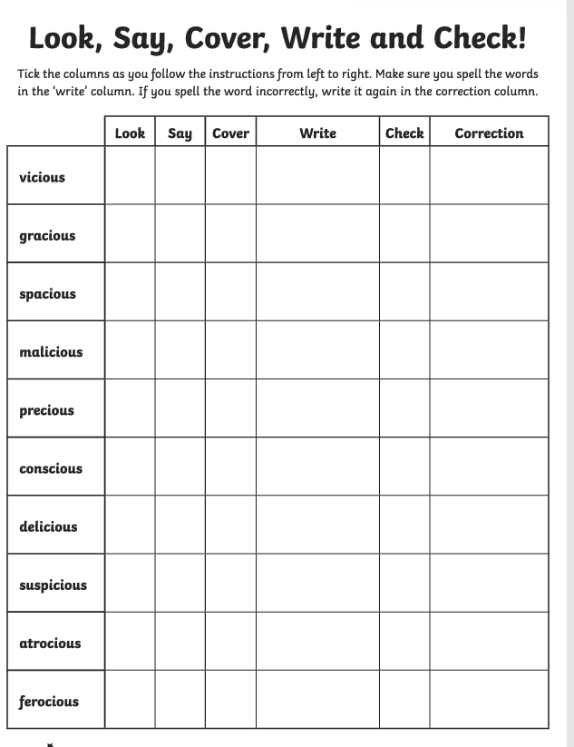

Slide 12
Reading
All children should now have a school library book- please let us know if not.
This needs to come into school with them daily please
We do daily Guided Reading activities where the children will work with adults in a rotation and all have a chance to enjoy our reading corner.
They will become familiar with how to answer Reading Comprehension questions but please do support them with their homework.

Slide 13
Timestables
We use TTRS every Friday to practise timestables in Year 5, with a mix of tests, using multiplication and division word problems and laptop activities.
At home please regularly practise the tables your child struggles with the most, or if your child is particularly confident with their multiplication recall, then you could practise with giving your child some word problems.
For example:
There were 9 packets of pens, each with 12 pens inside. How many pens were there altogether?
There were 30 children in the class and they were asked to make 4 teams. How many children could be on each team?
Here the children are using their reasoning skills too- they may see that 30 cannot be divided evenly by 4 and start finding solutions- such as 2 teams of 8 and 2 teams of 7.

Slide 14
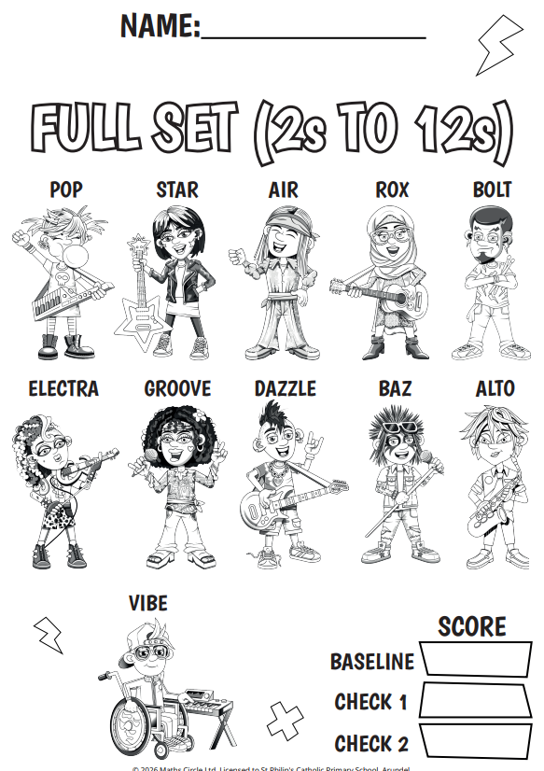
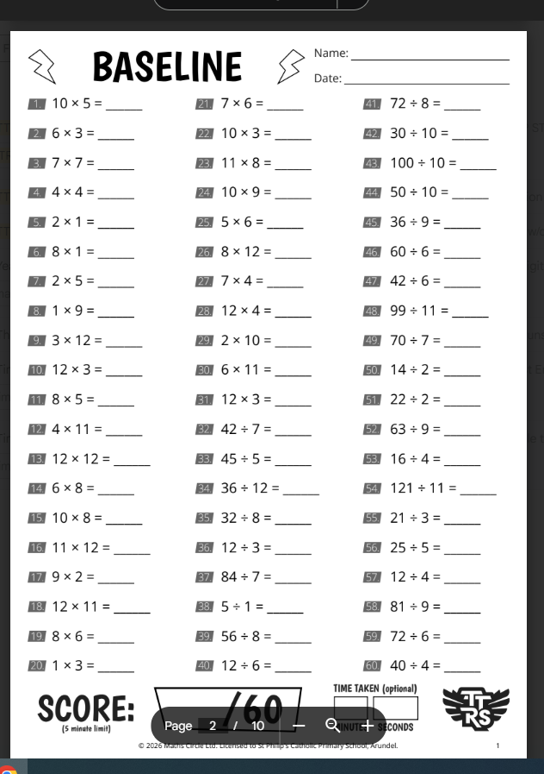

Slide 15
Curriculum Overview
We will be shortly sending home our Year 5 Curriculum Overviews that map out the learning for this half-term.
As a school we are no longer doing termly topics, but instead focussing on different areas of learning per half term.
For example, we have a History focus this half-term where we are learning about The Vikings and next half term we will be having a Geography focus.
You will receive a full overview about this each half-term.

Slide 16
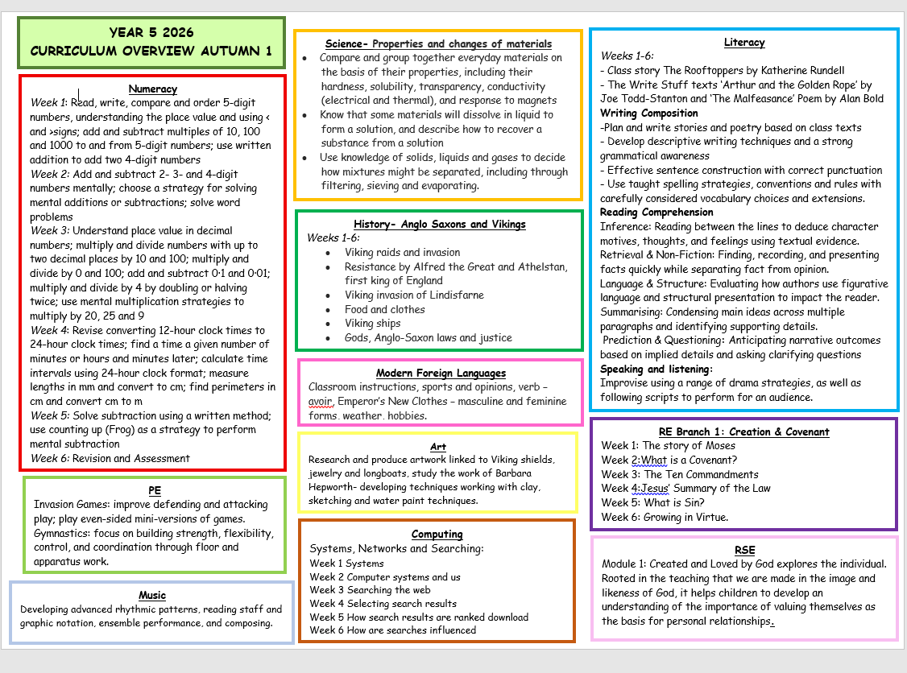

Slide 17
Notices
We will send out reminders when it is the Year 5 Forest School or Cooking dates
We have a fantastic trip to The Planetarium in Chichester in the Spring term, as well as visits to SPH for Sporting and Science events.
A Reminder
Please do not send your children into school with toys, including fidget toys. If you feel your child would find one useful please arrange to speak to myself or Mrs Griffiths as we do have resources in school.

Slide 18
Any Questions?

